Slide 1




YTP Careers Event
What are my options next year?

Slide 2


Agenda
DiSE progression
Dual-careers
Which path is right for me?
Timeline & Q&A
HE options, hearing from:
  University of Birmingham
  Leeds Beckett
  Loughborough University
  Loughborough College
  St Mary’s University

Slide 3



DiSE progression
  Your DiSE qualification holds 64 UCAS points.
  Remember to add these to your UCAS application - regardless if you think you’ll need them.
  Document to be shared late September on how to add.
  Not all universities see the numerical value, but all do see the skills you’ll develop.
  Title: Pearson BTEC Level 3 Diploma in Sporting Excellence.

Slide 4
DiSE progression
What is left to be completed this academic year?
October over-night camp (10th/11th October)
Dealing with the media 1 Dealing with the media 2 Health & Safety 2 Managing my dual-career 2
March camp (1 day) (20th/21st March)
Final amendments, resubmissions or missing professional discussions.
October over-night camp (10th/11th October)
December camp (1 day) (12th or 13th December)
Mental Health
Welcome back meeting Online - Weds 30th Sep (7pm)
IAP 2 Around October 2026
IAP 3 Around January 2027
Professioanl discussions to be completed throughout the year with your tutor - don’t forget these

Slide 5

Which path for me?
  Worthwhile knowing that University isn’t the only route.
  Consider:
    Higher Education institutions
    Employment
    Apprenticeships
  Balance out your sporting commitments alongside a potential career.
  As a Loughborough College learner, you can access our Independent Advice & Guidance (IAG) as well as any at your other college. Reach out should this be required.

Slide 6
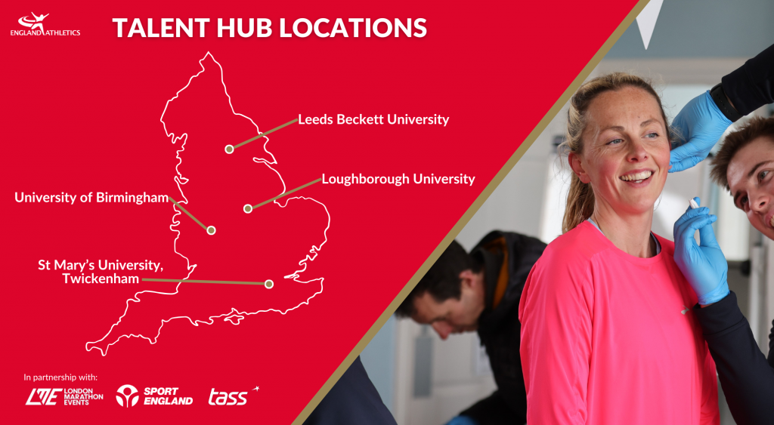
HE options

Slide 7

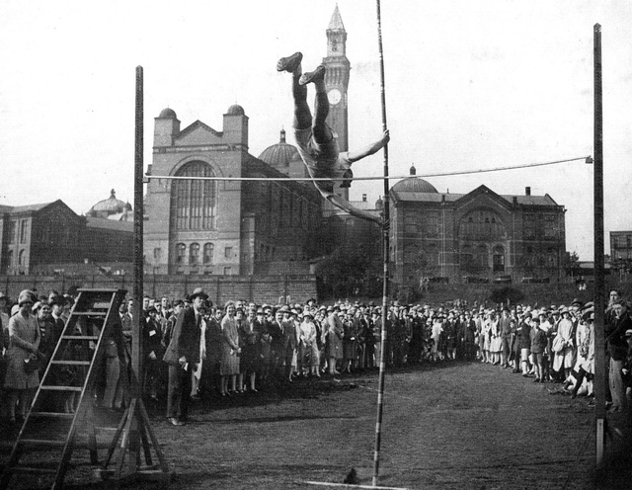

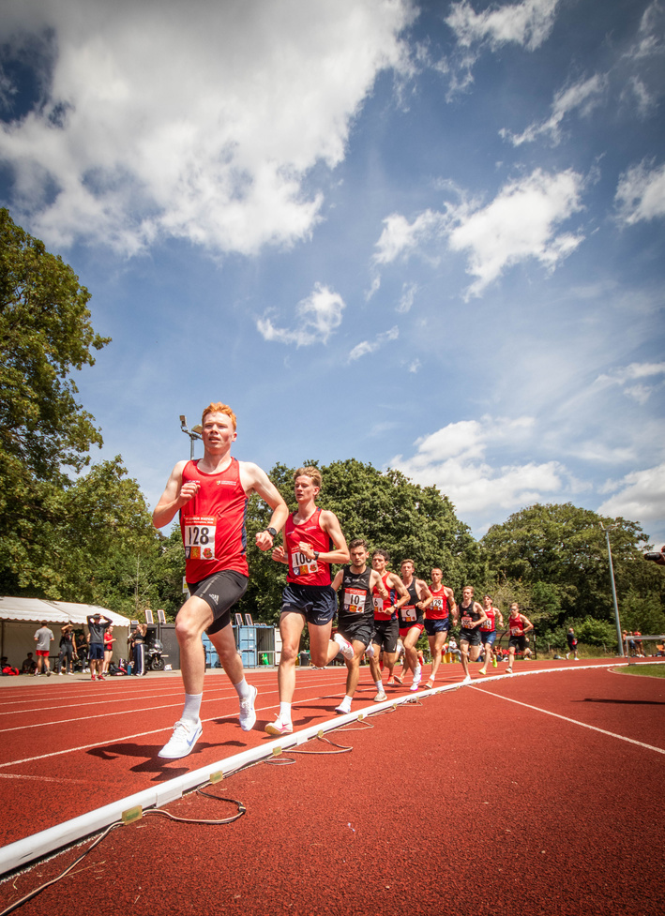
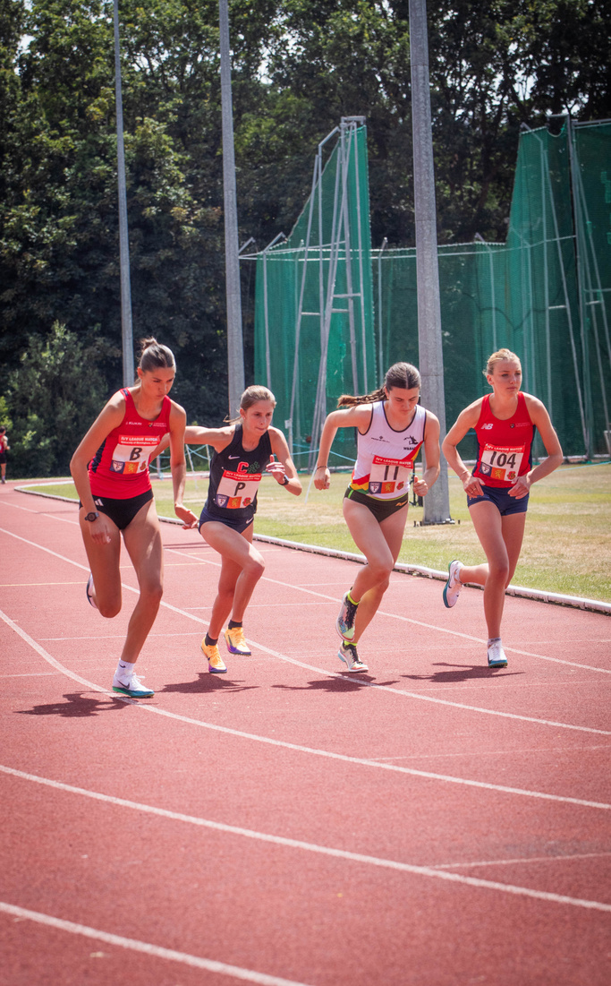
University of Birmingham
At the Heart of England and the home of Athletics!
The Athletics Talent Hub hosts athletes from across the West Midlands and a range of Universities including:
Birmingham City
Aston
UCB
Wolverhampton
Warwick
Worcester

Slide 8
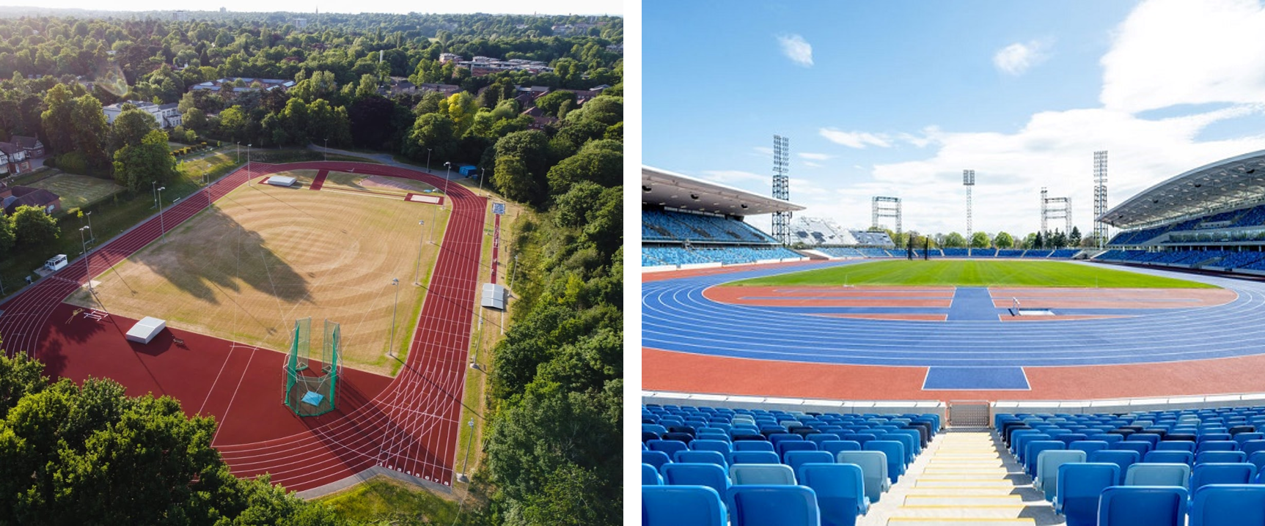
University of Birmingham

Slide 9






University of Birmingham
Team Staff & Athletes repping GB and England across the Globe since the Hub launched.
This year alone..............
A place to learn and grow...
From Criminolgy to the Classics
From Oldham to Oregon
and maybe from
From Longbridge to Los Angeles

Slide 10


Leeds Beckett University

Slide 11







Leeds Beckett University
}

Slide 12

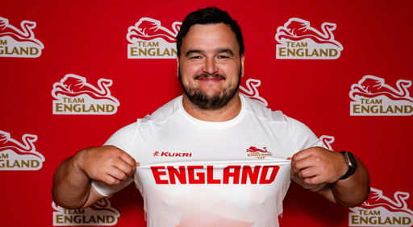
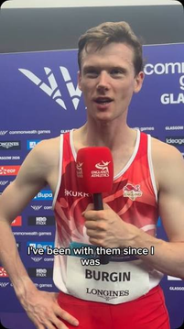
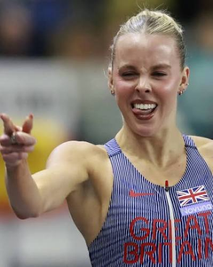
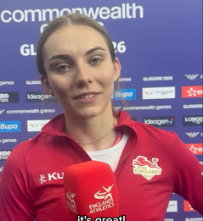
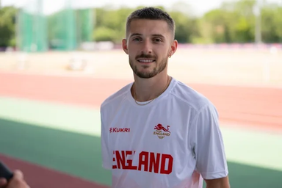
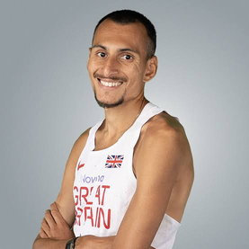

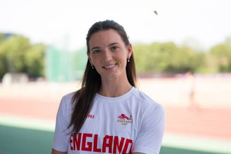

Leeds Beckett University
Cameron Corbishley
Laura Muir
Jade O’Dowda
Keely Hodgkinson
Lucy Hadaway
Emile Cairess
Archie Yeo
Scott Lincoln
Marc Scott
}
Alex Bell
Alex Botterill
Max Burgin
Tiarnan Crorken
Phil Sesseman

Slide 13


















Loughborough College (HE)
BSc (Hons) in Applied Sports Science
BSc (Hons) in Sports Management
BSc (Hons) in Sports Coaching
BSc (Hons) in Sport and Exercise Therapy
BSc (Hons) in Strength and Conditioning
BEng (Hons) in Sustainable Engineering
BA (Hons) in Business and Management
BA (Hons) in Events Management & Marketing
All courses require 96 UCAS Points (MMM or CCC)
Sport & Exercise Therapy requires 112 UCAS Points (DMM or BCC)
English and Maths GCSE - Grade 4 or C
*Accredited by the Society of Sports Therapists

Slide 14
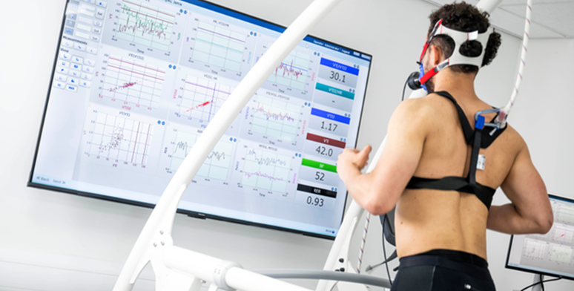

Loughborough College (HE)
  Degree from Loughborough University
  Eligible to represent Loughborough University in BUCS
  Member of Loughborough Students’ Union
  World-Class facilities - millions of £ of investment
  Smaller Class sizes / more 1:1 support than most Universities.
  Academic Tutor Support
  Flexible Timetable to work around sports commitments.
  Varied and applied assessments and delivery methods.
  High student satisfaction levels (NSS).
  Opportunity to ‘Stretch Degree’ for elite athletes.
  >1000 Degree level students
  Recruit Nationally and Internationally

Slide 15
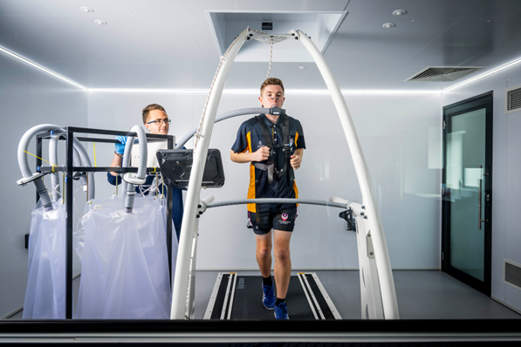
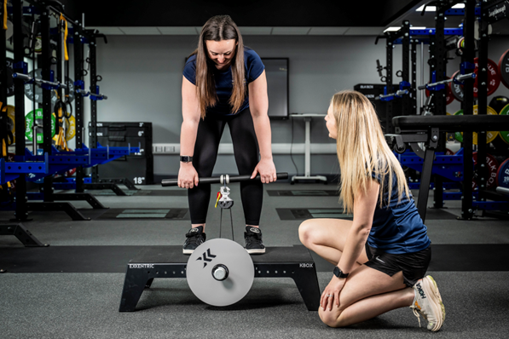
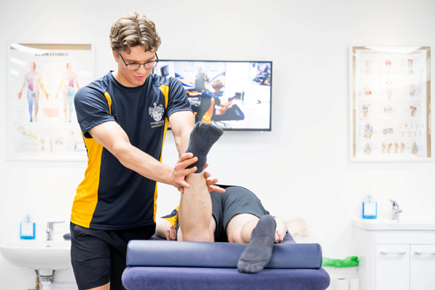
Loughborough College (HE)
Academic Tutor Support :
  Academic support for students
  1:1 Meetings
  Study skills – essay or report writing, referencing, presentation skills, searching for literature, revision tips, understanding feedback.
  Pastoral Support – Help in accessing additional support: wellbeing and counselling services.
Well-Being Support :
  HE Well-being team for dedicated support
  Mental Health and Wellbeing
  Anxiety
  Social isolation
  Independent living skills
  Relationship breakdowns
  Bereavement
  Finance and budgeting
  DSA guidance
Other Support :
  Elite Sport Welfare Officer
  International Athlete Support
  Liaison with Lifestyle Advisors/Coaches
  HE building and library section
  Finance Team
  Flexibility: Elite Athletes
  Personal Academic Tutors
  Student Experience Offer
  Trips and Courses
Maximising Student Potential

Slide 16
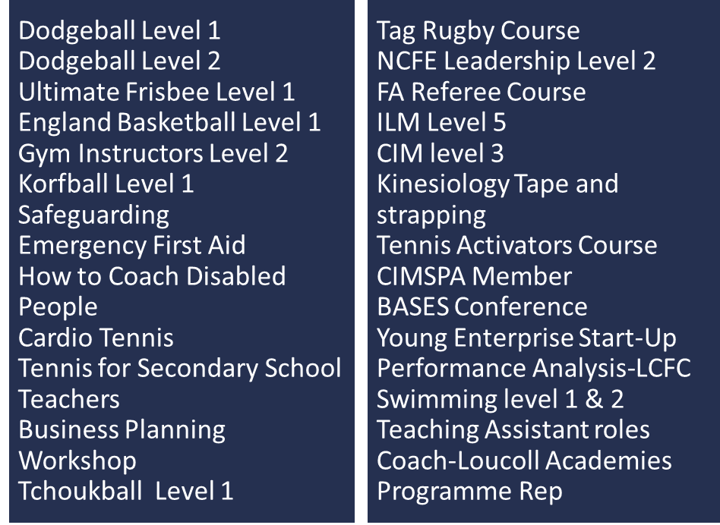
Loughborough College (HE)
Preparing our Students
OPPORTUNITIES
Student Employability and Enhancement Fund
Sport and Exercise Therapy Clinic & Sports Science Hub
Student Development Weeks
Employability and Placement Modules
Young Enterprise
Coach and Volunteer Academy
Above: Courses that our students have undertaken during their time studying with us

Slide 17




Loughborough University
Loughborough England Athletics Hub

Slide 18

Loughborough University
Accessible Support
Strength and Conditioning
Soft Tissue/Sports Massage
Physiology/Testing
Coaching
Nutrition
Athlete
Biomechanics
Physiotherapy
  Practitioners working closely with hub athletes across all of these disciplines.
  Whatever support you need, it’s there for you!
Psychology
Performance Lifestyle

Slide 19
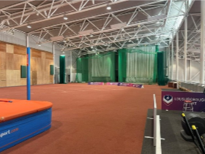
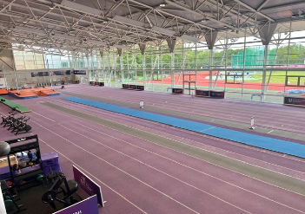
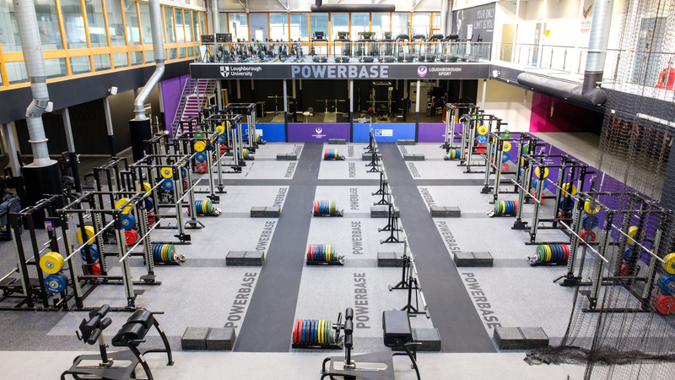

Loughborough University
Facilities
  HIPAC - Outdoor track, indoor 100m track, indoor throws cage + jumps, performance gym.
  Powerbase - 3 x gyms
  Diagnostic Equipment - Force plate, cameras, lighting, OptoJump, biomechanics team.
  Performance Athlete Accommodation

Slide 20

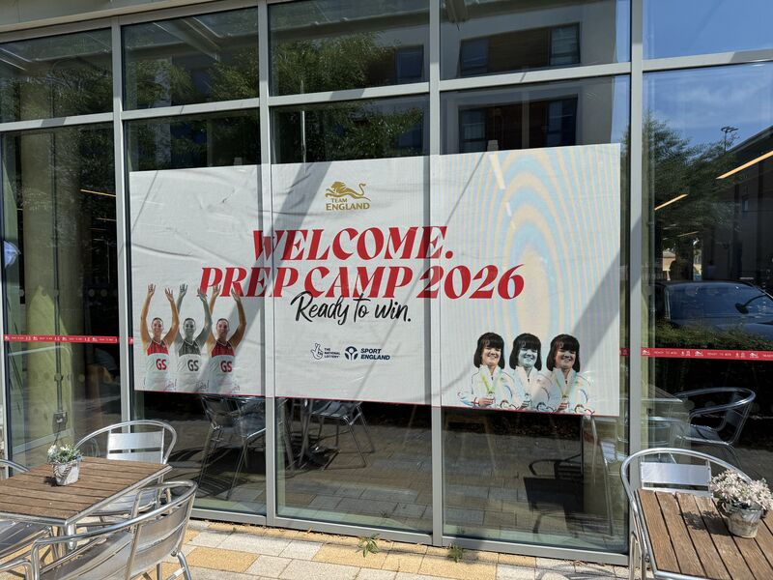
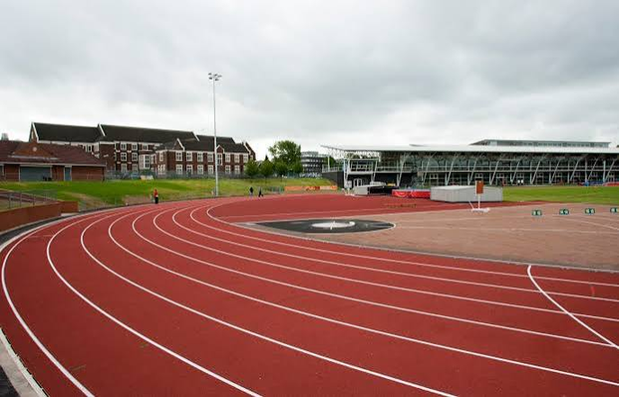
Loughborough University
Partnerships
  England Athletics - We have created an environment where we can support athletes progressing through the pathway. ​
  The EA Hub – Largest hub with 39 athletes (2025/26).
  UKA – We have a world leading diagnostic training facility​.
  Commonwealth Games - Team England prep camp​ based here.

Slide 21

Loughborough University
Success
  18 x EA Hub athletes with international representation in 25/26.
  Big contributions to Lboro winning BUCS athletics champs indoors + outdoors.

Slide 22

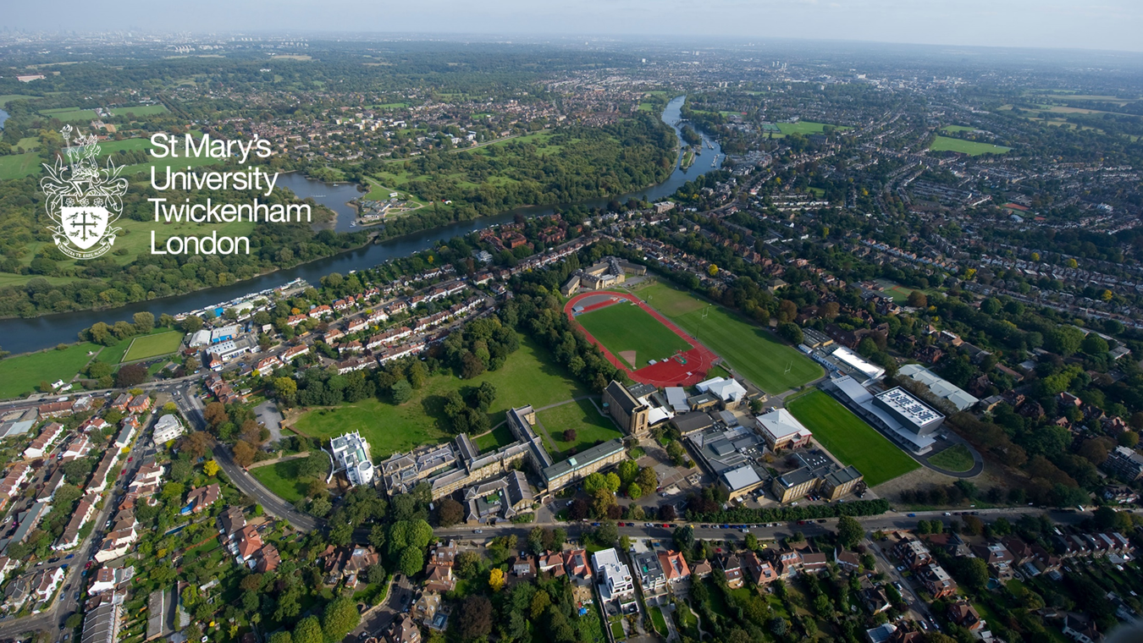
St Mary’s, Twickenham

Slide 23
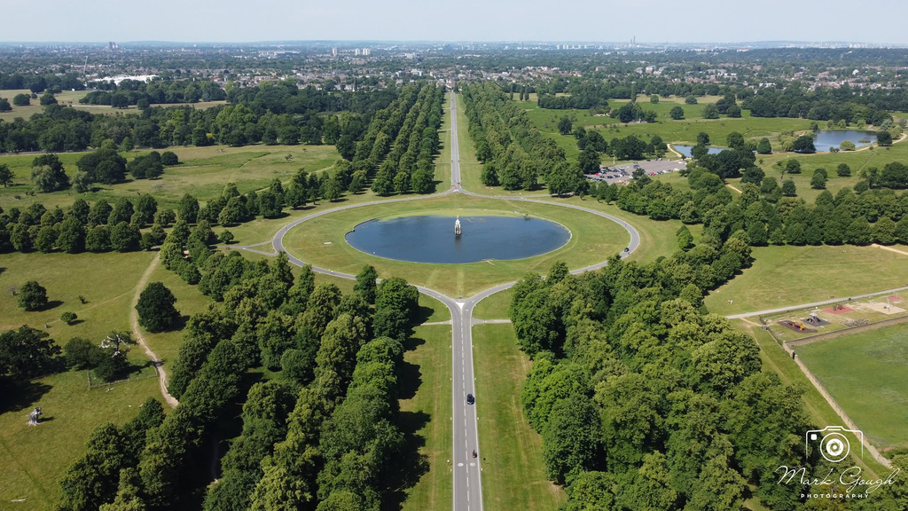
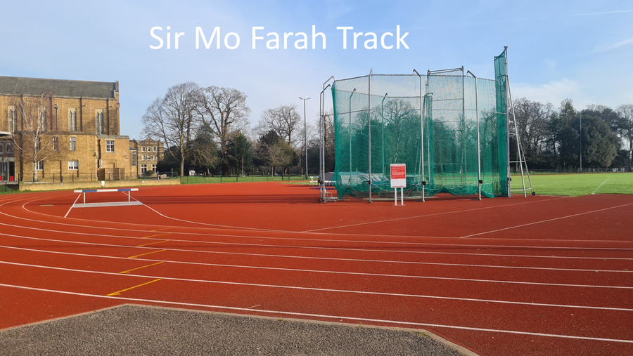


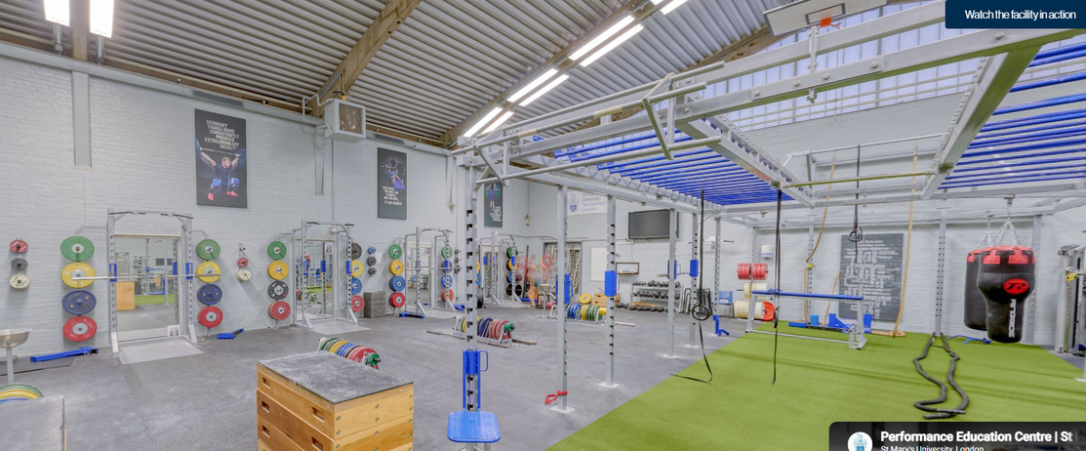



St Mary’s, Twickenham

Slide 24
St Mary’s, Twickenham
Endurance Performance Centre
St Mary’s EPC provides an endurance running programme and an environment that is known internationally as one of the best training setups in the world. The EPC has the following mission.
Mission:
To provide an endurance performance environment that supports, challenges and develops elite runners, inspires beginners, fosters and tests talent and promotes excellence in the coaches who work with them.
St Mary’s provides a perfect environment for all standards of runner. Dedicated on-site accommodation, the Sir Mo Farah Athletics Track, a Performance Education Centre (PEC) and extensive running in nearby Bushy and Richmond Parks. Alongside this, runners can access world-class coaching and support services; expertise that has been developed since the programme started in 2001.
Over the past decade St Mary’s has developed a growing reputation as one of the country’s top endurance venues with athletes such as Mo Farah, Joe Wigfield and Adelle Tracey along with groups from Kenya, Australia, New Zealand and the US choosing to base themselves in the area.

Slide 25

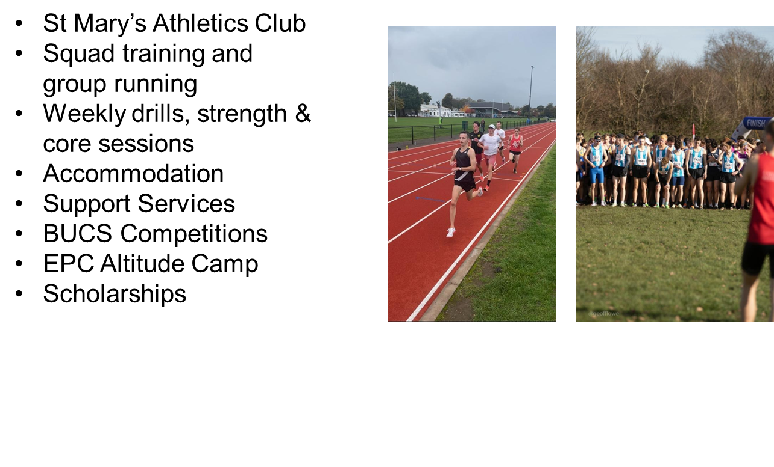
St Mary’s, Twickenham

Slide 26



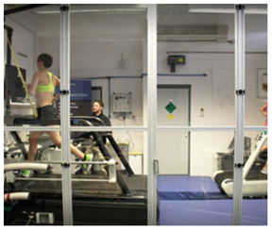
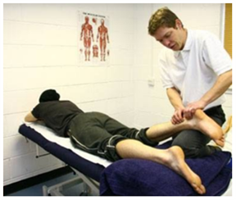
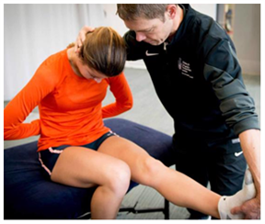
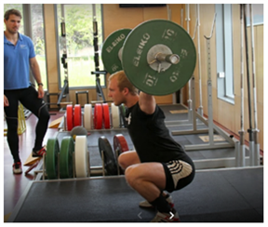
St Mary’s, Twickenham
Dedicated onsite Athlete Halls:
  Clive S & U
  University vacation time accommodation arrangements
Physiology ( VO2 Max Analysis)
Sports Massage (rehab degree)
Physio (TASS)
S&C (TASS)

Slide 27


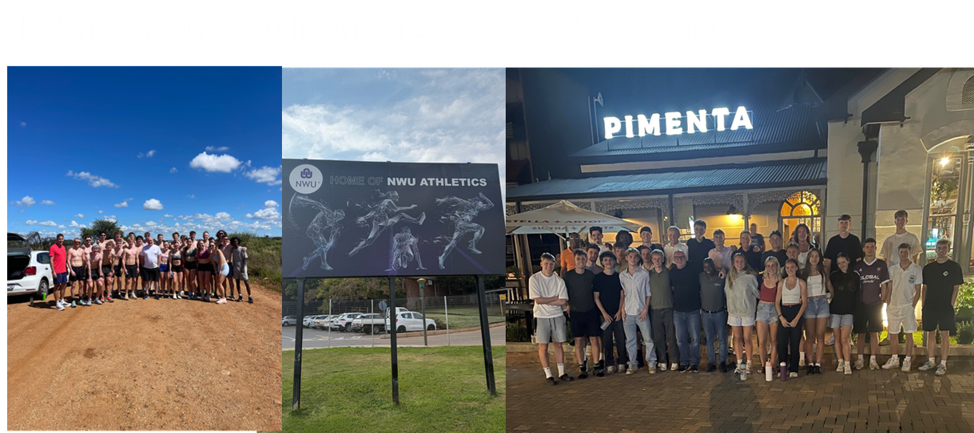
St Mary’s, Twickenham

Slide 28
Including DiSE in my personal statement
  It’s important to note the skills, knowledges and behaviours you’ll develop over your two-year DiSE programme.
  Expand on key transferable skills between being an athlete and your aspirational pathway.
  Examples will be shared in the coming weeks to help you understand how best to embed DiSE into your personal statements and potentially job applications.
  Communication
  Digital literacy
  Entreprenurial
  Leadership
  Problem solving
  Reliability
  Resilience
  Self motivation
  Team work
  Time management

Slide 29



AOB
Contact
Steph Tirrell - steph.tirrell@loucoll.ac.uk
Tom Boardman - thomas.boardman@loucoll.ac.uk
Talent HUB contacts
Birmingham - Andy Paul (apaul@talentpathway.org.uk)
Leeds - Andi Drake (a.drake@leedsbeckett.ac.uk)
Loughborough University - Jack Foot (j.foot@lboro.ac.uk)
Loughborough College - Hannah Knatt (hannah.knatt@loucoll.ac.uk)
St Mary’s - Craig Winrow (craig.winrow@stmarys.ac.uk)

