Slide 1
Welcome to A Level English Language A level applicant taster session

Slide 2
Introduction to English Language
In A level English Language you will:
Develop a deep knowledge of how the English language works
Engage creatively with areas of topical debate
Explore language in use in various contexts
Carry out an independent investigation in an area of particular interest to them.

Slide 3
Specification at a glance
Course structure
OCR specification
Unit 1: Analysing and comparing texts
Introduction to linguistic, close textual analysis
Unit 2: Gender and Power
Unit 3: Language acquisition and change
Writing about a topical issue
Learning about comparing and contrasting spoken and written language
Analysing texts based on gender and power theories
Learning about how children acquire language and how language has changed over time.
Unit 4: Coursework
Independent Language Research
Academic poster

Slide 4
Assessments
Paper 1
Exploring Language.
Apply various methods of linguistic analysis, and engage with current debates around language use.
Section A: Language under the microscope
Section B: Writing about a topical language issue
Section C: Comparing and contrasting texts.
Paper 2
Dimensions of Linguistic variation
Explore language use in particular contexts across time and place.
Section A: Child language acquisition
Section B: Language in the media
Section C: Language change.
Coursework
Independent language research
Non-exam assessment
Pursue your own language investigation, developing valuable research and communication skills.
Section A: An independent investigation –pursue an area of study of particular interest to you
Section B: The academic poster –present your research in a concise and visually accessible way.

Slide 5
The difference between GCSE English and A level English Language

Slide 6
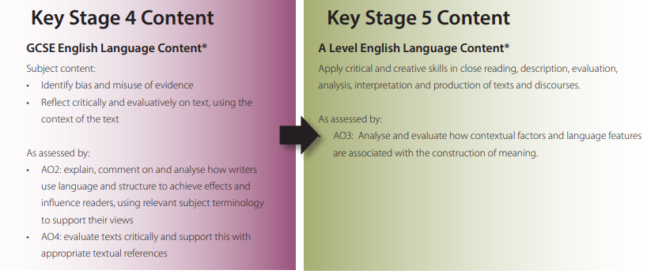
The difference between GCSE English and A level English Language

Slide 7
Activity
This activity puts you in the role of a language detective trying to solve a crime. The police need your help to work out who might have sent an abusive social media message from an anonymous account to a local politician. They have three suspects in custody and your job is to offer a view on which one you think is most likely to have sent the message, based on possible language clues.
Proceed to the next slide for instructions…

Slide 8
• Read Exhibit 1, the abusive message that the police are investigating. Is there anything that stands out in this message as being potentially interesting about how language is being used?
• Social media messages about the same issue which were used to identify three suspects. Read through these in turn, again making a note of anything that strikes you as interesting about how language is being used.
• Based on this small amount of data, have you got any suggestions about who might have sent the abusive message? Write a short police report explaining your thoughts. Try to pin your thinking down to specific bits of language evidence in the data.

Slide 9
Exhibit and messages
Data sets Exhibit 1: the abusive message
‘Hope your really proud of yourself for what you done but you gotta no that one day your gonna get payback!!! We have had enough of politicians like you not listening to us, you should of listened!!! Watch your back’
Suspect 1’s social media message
‘I don’t like what’s been happening in this area since the new housing development started. This used to be a nice place to live!!! I’m so disappointed in are local representatives for not sticking up for us!!!’
Suspect 2’s social media message
‘When are local councillors gonna realise that they should of been standing up for us and not for they’re mates in the big building firms, these people are gonna make a fortune from this’
Suspect 3’s social media message
‘Your joking! Are they seriously going to build 200 new houses on the fields up by the hospital?! That is crazy. There’s not enough facilities for the rest of us at the moment. Madness!!!’

Slide 10
Activity Answers
On balance, Suspect 2 is the most likely match. While there are some differences, there are more similarities than the others. There’s use of second person address in the threatening message and not in the other evidence, but then if you’re threatening someone you might tend to address them directly. Of course, if people are posting messages online, not only can they hide their identity, they can also pretend to be someone else in their language style. There are quite a lot of features in the threatening message and some of those might have been deliberately inserted to hide the sender’s real style!

Slide 11
Thank you
https://www2.aston.ac.uk/lss/research/lssresearch/forensic-linguistics https://www.thetext.co.uk/

