Slide 1
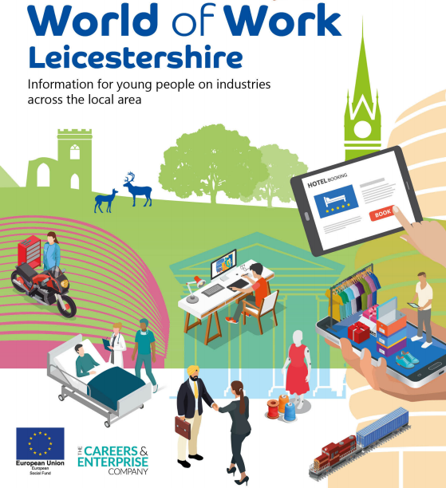
World of Work Leicestershire Tourism and Hospitality
Careers and Employability Team

Slide 2
Tourism and Hospitality
This industry includes events, hospitality services, hotels, pubs, tourist attractions, night clubs, festivals and restaurants.
If you like meeting people, and are enthusiastic and organised, then it could be for you.
There are plenty of entry level jobs from which you can quickly progress!
The National Space Centre in Leicester is the UK’s only space themed visitor attraction; or how about a zoo, international hotel chain, conference centre, airline, theme park, exclusive restaurant or tour guide... take your pick!

Slide 3
Local employers
East Midlands Airport The National Space Centre Conkers Twycross Zoo King Richard III Visitor Centre Twin Lakes Wistow Maze Stonehurst Family Farm | Meridian Leisure Park Local museums and tourism centres Hotels, bars and restaurants Major sporting venues Conference centres Casual work is often available through festivals, seasonal and sporting events

Slide 4
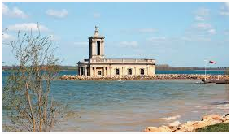
What is happening?
In 2018 £1.86bn was injected into the Leicestershire economy by 34.5 million visitors.
The sector is a key provider of first jobs for young people. Skill shortages include chefs, management roles, language skills, front of house, catering support, tour guide, and cabin crew.
Social media skills are also useful as most companies have an on line presence.

Slide 5
What is happening?
Three local attractions were included in the Lonely Planet Ultimate List 2019, which were
• King Richard III Visitor Centre
• Bradgate Park
• Diwali celebrations in Leicester
The sector employs 37,000 people. People are travelling and eating out more, so the sector is growing. With so many eateries, tourist destinations and accommodation to choose from, organisations need to be creative with fresh ideas to make their offer stand out.

Slide 6
What is happening?
Work is often fast paced, and there are great opportunities to progress and travel. There is also satisfaction in delivering a good service to visitors.
There are growing numbers of vegetarians and vegans, and clients who value sustainability, that hotels and eateries need to cater for.
Leicester and Leicestershire regularly host a range of major cultural, sport and business events and festivals (including the Leicester Comedy Festival); work is often seasonal and part-time.

Slide 7
What is happening?
Attractions such as Conkers, Twin Lakes and Leicester Outdoor Pursuits Centre employ a high percentage of young people.
There are some picturesque historical sites here, including Belvoir Castle, the Great Central Railway and Bosworth Battlefield.
Twycross Zoo is a world-renowned primate centre and welcomed 585,000 visitors in 2018.
Foxton Locks in Harborough has the largest flight of staircase locks on the English canal system.

Slide 8
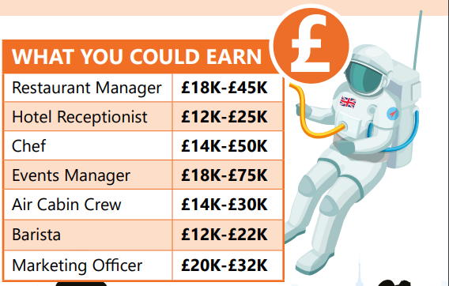
Earnings

Slide 9
Skills and qualities
presentation skills
problem solving
team work
communication
literacy
negotiation skills
customer service skills

Slide 10
Tourism and Hospitality Links
https://careerscope.uk.net/
http://hospitalityguild.co.uk/
https://www.visitleicester.info/
http://www.careersthatmove.co.uk/
https://www.eastmidlandsairport.com/
https://www.goleicestershire.com/

