Slide 1
Welcome to A Level Art, Craft and Design

Slide 2
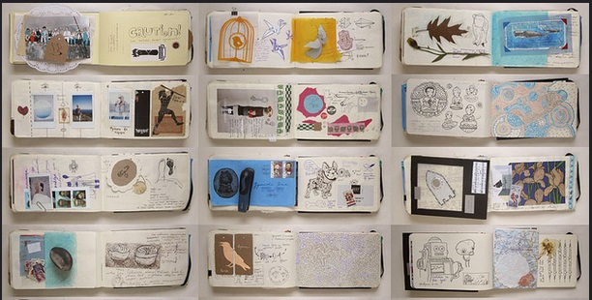
Subject information
What will you learn in A-level Art?
You will learn a range of new skills and develop those you already have. You will discover new artists and art forms to influence your development. You will be encouraged to work experimentally, to take risks and try new methods and processes of image making. You will be given themes to encourage you to create imaginative and expressive responses.

Slide 3
Specification at a glance
Year 12
Year 13
Skill Building
In the first and second term you will complete a variety of tasks that introduce you to different techniques and materials. You will also be introduced to and select a variety of different Artists to research and create a personal response to.
Unit 1 Personal Investigation
Towards the end of year 12 You will start to prepare for your Personal Investigation by selecting a theme to research and investigate.
Unit 1 Personal Investigation
You will continue to research and develop outcomes for your Personal Investigation. You will also produce a piece of written research that looks at some wider aspect of your theme. This will run from September to January.
Unit 2 Externally Set Task
From February to April you will research one of the set themes from the exam paper and then have 15 hours to produce, unaided, your outcome.

Slide 4
Assessments:
Component 1: Personal Investigation
A portfolio of work created in response to a theme leading to a finished outcome.
48%
Unit 1:
60%
Related Study:
1000 word essay that is related to the Personal Investigation
12%
Externally Set Task:
A choice of seven themes set by OCR to create a personal response. Includes a 15 hour exam to create a final piece or pieces.
Unit 2:
40%

Slide 5
Entry requirements
5 GCSEs including Maths and English at a Grade 4
GCSE grade 4 minimum in an Art or Design subject
A portfolio of your work showing a range of skills and ideas

Slide 6
More information
Why study A-level Art?
In preparation:
A-level Art will give you the skills to develop your capacity for independent working allowing you to develop a portfolio that can be used for university applications to a wide range of art and design graduate courses. You will develop a critical understanding of the working methods that allow artists and designers to produce individual creative work. You will have the opportunity to learn about a wide range of historical and contemporary artists, that will inform your current and future practice.
Set up a Pinterest page to collect examples of art and design that inspire you
Start a small sketchbook of drawings and observations.
Take photos of landscapes, people, places and things that interest you.
Visits museums and start a get an idea of the kind of art you want to create.

Slide 7
A small task

Slide 8
Any questions
6thFormAdmin@loucoll.ac.uk
Follow us……..
@Lboro6thForm

