Slide 1
GOOD MORNING AND WELCOME
Writing skills are one of the most powerful tools you have and something you need to keep developing throughout your life. So here at Loughborough College, no matter which course you are following, your tutors will be focusing on improving those skills.
Your writing can have an amazing effect on people: it can make them laugh, cry, think, understand, hurt, wonder, question and be amazed.
So – on to your task …

Slide 2
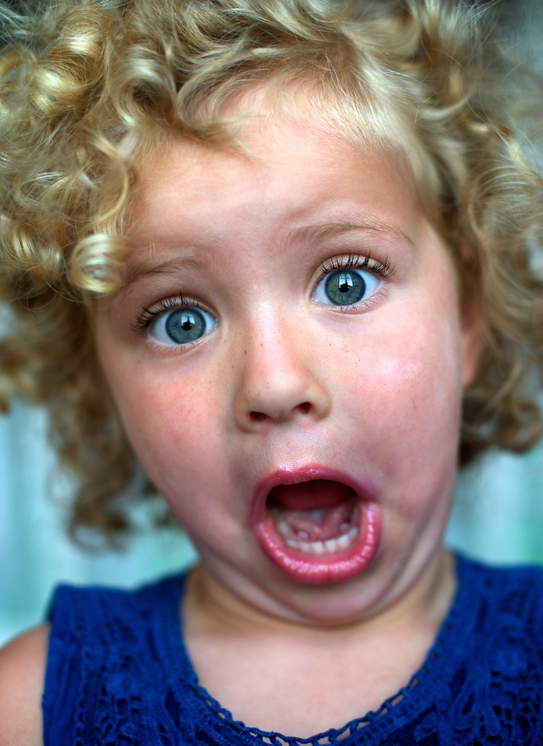
THE TASK Write a short story
THE CHALLENGE
Use no more than 500 words

Slide 3
WHAT MAKES A GOOD STORY?
STEP 1
The main idea or message.
What do I want my readers to know?
What do I want my readers to feel?
‘A short story must have a single mood and every sentence must build toward it.’

Slide 4
WHAT MAKES A GOOD STORY?
STEP 2
The Story
One or two characters
The setting
The end
The beginning

Slide 5
WHAT MAKES A GOOD STORY?
STEP 3
The Words
Happy or ecstatic?
Unhappy or distraught?
Green or emerald?

Slide 6
WHAT MAKES A GOOD STORY?
STEP 4
The Technical Stuff
Accurate punctuation
Clever punctuation
Spelling

Slide 7
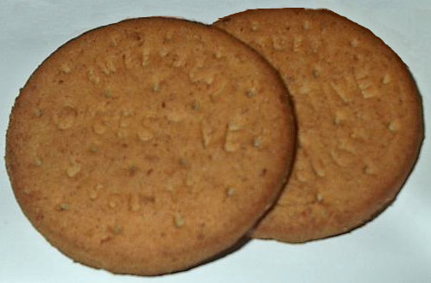
WHAT MAKES A GOOD STORY?
STEP 5
mathsandenglish@loucoll.ac.uk

Slide 8
FOR MORE
https://blog.reedsy.com/how-to-write-a-short-story/

