Slide 1
World of Work Leicestershire Creative Industries
Careers and Employability Team

Slide 2
Creative Industries
The creative sector is about creating original ideas and products and is often split into three distinct parts: arts, culture and creative media.
Job areas include design, film and video, social media, advertising, music, crafts, photography, computer games and animation.
The diversity of the local population offers a wide selection of arts, music and cultural events.
The sector employs around 16,000 people locally.

Slide 3
Local employers
Checkland Kindleysides Curve Jadu Standout Design Champions (UK) Plc Anicca Digital Big Dog Agency Trident Phoenix Arts Centre Tetenal Ltd Go Inspire | Rare Ltd Affixxius Films Soar Valley Press Taylor Bloxham Seed Creativity Creative 62 Colab Creation Local theatres Galleries Cinemas

Slide 4
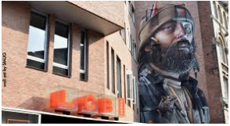
What is happening?
The Cultural Quarter in Leicester is home to many creative businesses at the LCB Depot (which provides workspace for creative businesses), Curve, Makers Yard and Phoenix Square.
Creative centres in the county include the Ferrers at Staunton Harold and the Atkins Building in Hinckley. County festivals include Arts Fresco in Market Harborough, Glastonbudget at Wymeswold and the Timber Festival near Ashby.
The top three areas for jobs locally are in computer consultancy activities, specialist design and computer programming. Advertising and performing arts are also strong. Many roles are digital or technology based.

Slide 5
What is happening?
The trend to produce videos for business websites is growing.
Job competition is high. You need to be tenacious with strong networking skills. Opportunities are often with very small businesses and work experience is useful. Employers value young people with combined sets of skills, such as artistic and scientific skills.
Many people work freelance which means less job security.
Hawthorn Theatrical are an award winning creative technical event production company in Melton.

Slide 6
What is happening?
The Creative Leicestershire organisation works to develop new and existing small creative enterprises across Leicester, Leicestershire and Rutland.
Entry level roles include marketing assistant, apprentice light technician, apprentice animator, assistant make-up artist, front-of-house, business and administration roles.
Skills shortages include technician (especially software and digital media), foreign languages, production fundraising, 3D designers, production managers, programmers, broadcast engineers, social media specialists, illustrators, coders, and data management.

Slide 7
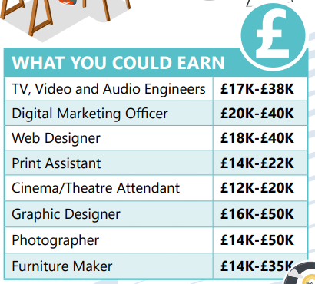
Earnings

Slide 8
Skills and qualities
ICT problem solving attention to detail team work communication planning | creativity presentation skills leadership innovation business

Slide 9
Creative Industries Links
https://ccskills.org.uk/index.php?/careers
https://www.screenskills.com/
http://www.lcbdepot.co.uk/
https://www.creativeleics.co.uk/
https://www.bubble-jobs.co.uk/
https://getintotheatre.org/

