Slide 1
Welcome to A Level Physical Education

Slide 2
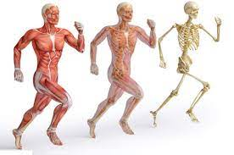
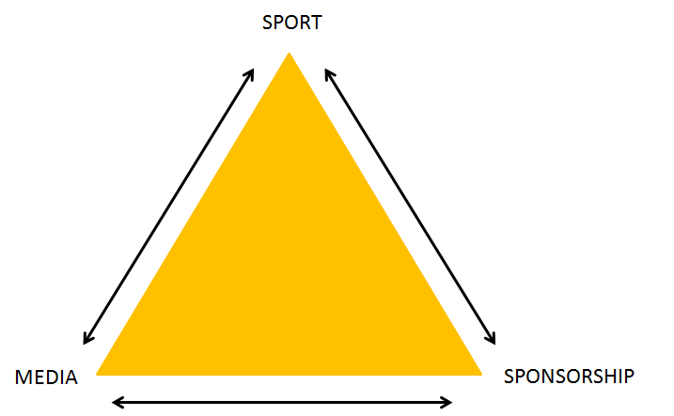
Subject information
What is the course covering?
Anatomy and Physiology Psychology Sport and society

Slide 3
Specification at a glance
Year 12
Year 13
Paper 1
Anatomy and Physiology
Biomechanics
Cardiovascular and respiratory
Diet and nutrition
Training methods
Paper 2
Skill acquisition
Sport psychology
Sport and society
Paper 1
Energy systems
Sports injuries
Linear and angular motion
Paper 2
Memory
Group dynamics
Confidence and leadership
Sport, sponsorships and the media
Sport technology
Talent identification
70%

Slide 4
Assessments
Paper 1:
Paper 2:
Practical:
Anatomy and physiology and exercise physiology
Sport Psychology and sport in society
Your sport and coursework
140 marks
40% of A-Level
2 hours
2 hours 30 min
100 marks
30% of A-Level
30% of A-Level

Slide 5
Practical element
Practical
Coursework
Worth 15% of final grade
You get assessed in one sport and scored out of 40
Examiners are harsher at A Level than GCSE!
Worth 15% or final grade
For your sport you are requires to analyse a performer and create a training plan for them.
Out of 40

Slide 6
Entry requirements
Maths, English and Science at Grade 6
Strongly recommend GCSE PE but not a requirement
You play a sport of at least county level

Slide 7
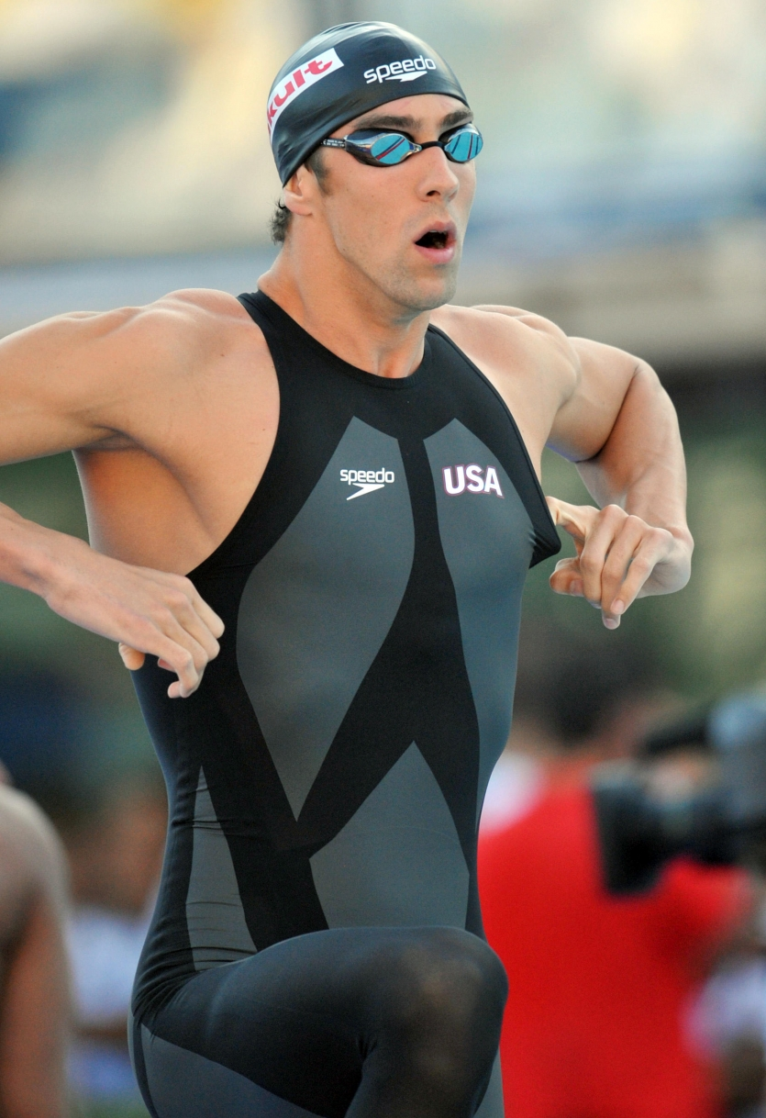
Activity (10 minutes)
Your task is to research a piece of banned technology from a sport of your choice.
Once you have decided which one to research I would like you to find out:
Why was it banned?
How did it impact the sport? (did it break records)
Was it giving some athletes an unfair advantage?
Any other useful information

Slide 8
Activity (10 minutes)
Your task is to research a piece of banned technology from a sport of your choice.
Once you have decided which one to research I would like you to find out:
Why was it banned?
How did it impact the sport? (did it break records)
Was it giving some athletes an unfair advantage?
Any other useful information

Slide 9
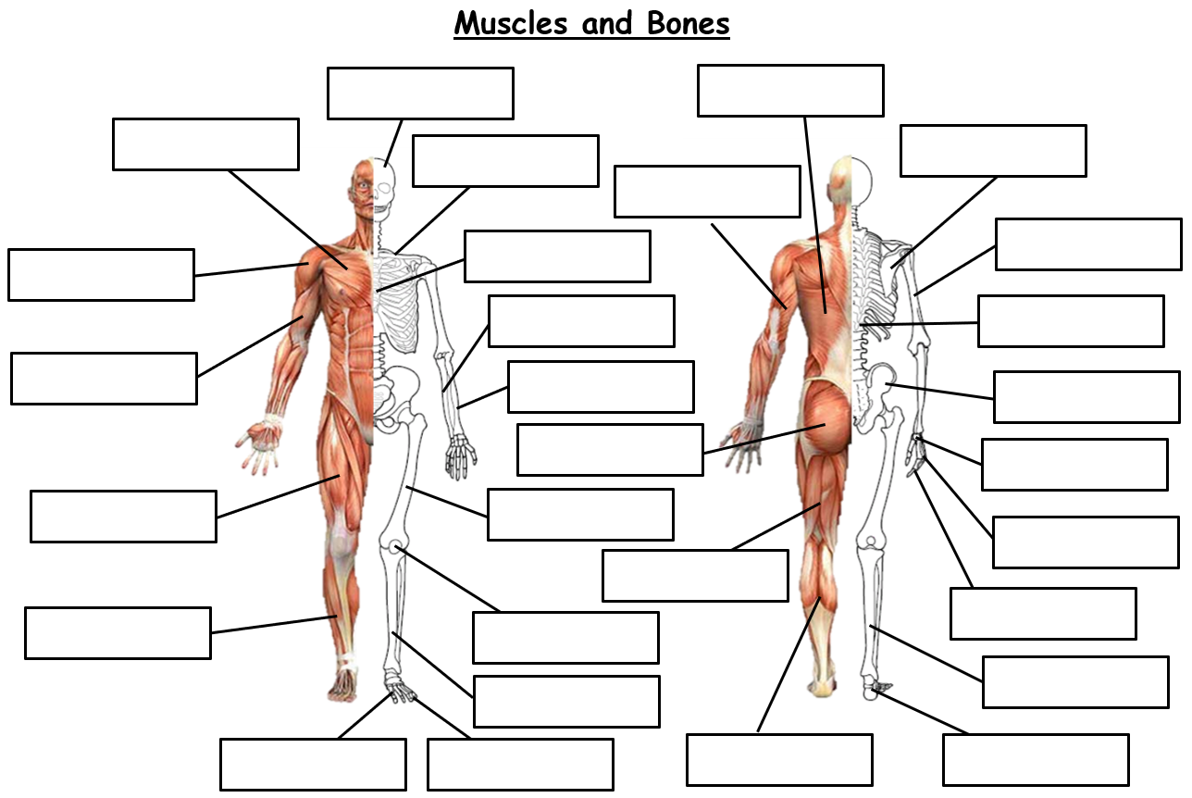
Label the skeleton (10 minutes)

Slide 10
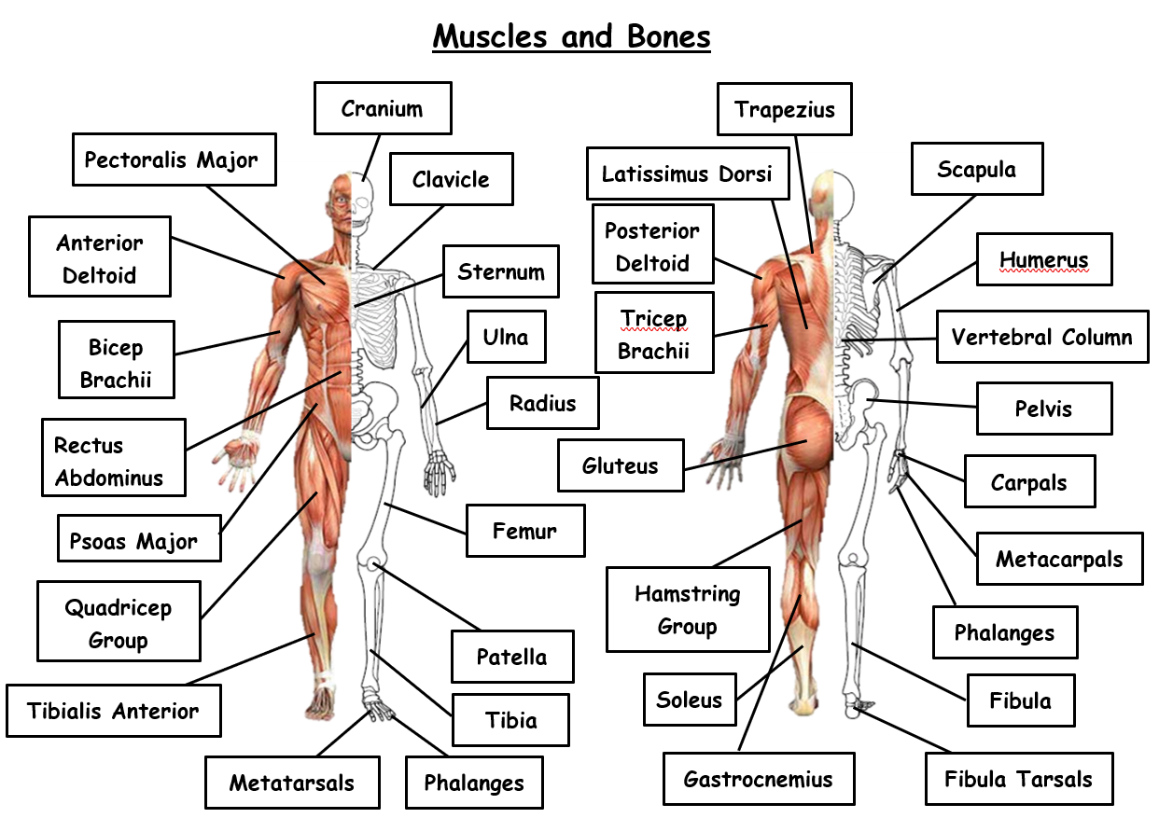

Slide 11
Applicant event Kahoot
(hover over the link, hold ctrl and click on the link)

