Slide 1
Welcome to A Level Politics

Slide 2
Subject information
The study of politics is an interesting and thought-provoking subject to study at A Level. Not only will you learn key concepts, theories and ideas, but you will apply these to current issues both in reading the reality of the UK and but also to events across the world.
You will study the Edexcel syllabus in which you will study three components. The first centres on the politics and of the UK and core political ideas, the second on the UK’s government and non-core political ideas. In the third you will study the US political system and government.

Slide 3
Specification at a glance
Year 12
Year 13
Component 1 UK Politics
Democracy
Political Parties
Electoral Systems
Voting Behaviours
Conservatism
Liberalism
Socialism
Component 2 UK Gov.
UK Constitution
Parliament
Component 2 UK Gov Cont.
PM and Executive
Supreme Court
Feminism
Component 3 Government and Politics of the USA
US Constitution
Congress
Presidency
Supreme court and civil rights
US democracy and participation
Comparative theories

Slide 4
Assessments
Paper 1:
Paper 2:
Paper 3:
UK Politics
UK Government
Politics and Government of the US
2 Hours
84 marks
33.3%
2 Hours
2 Hours
84 marks
33.3%
84 marks
33.3%

Slide 5
Entry requirements
5 GCSEs including Maths and English at a Grade 4
Have an awareness of any current significant political issues in both the UK and USA
Be prepared to share views and opinions in a constructive and supportive environment

Slide 6
Career opportunities
Politics
Non-Gov. Organizations and Int. Org.
Diplomatic service officer
Business development manager
Market researcher
Public affairs consultant
Politician’s assistant

Slide 7
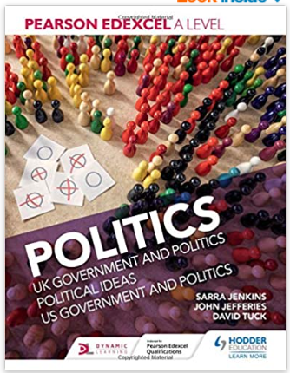
More information
Useful websites
Course textbook
Website with more information on the qualification:
https://qualifications.pearson.com/en/qualifications/edexcel-a-levels/politics-2017.html
Additional useful websites:
https://www.parliament.uk/
https://www.supremecourt.uk/
https://www.congress.gov/
https://www.whitehouse.gov/
https://www.hoddereducation.co.uk/subjects/government-politics/products/16-18/pearson-edexcel-a-level-politics

Slide 8
Skills that we aim to develop
Academic skills
Transferable skills
Exam prep
Communication skills
Argumentation and debate
Writing skills
Analytical skills
Presentation skills
Critical thinking
Team working
Independent study
Research skills
Time management
Work ethic

Slide 9
What we do in class

Slide 10
What we do in class

Slide 11
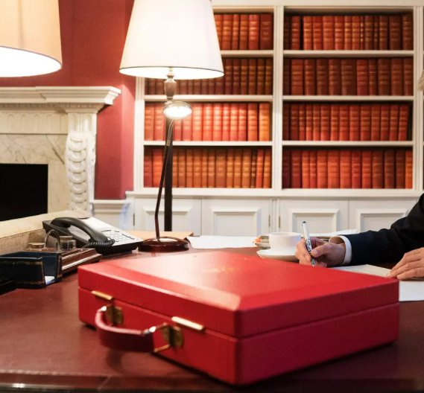
Let’s have a go now!
You’re the ruling Government and you’ve just had a look at the budget... It’s not good! There are going to have to be cuts (although if you can afford it you can raise the funding in some departments), but the question is where?!
Your aim is to save £1.6 billion pounds; you can only make cuts (or increases) according to the ideologies set out in the next slide. The departments you can cut from and their respective budgets are set out afterwards. You can cut (or increase) as much or as little as you want from each department, but you must cut from more than one. The more you cut the less successful that department will be! The more you increase the more successful it will be!

Slide 12
Let’s have a go now! – Choose a party.
Liberal Party
As the Liberal Party you believe in a small Government. State interference should be kept to a minimum unless it serves to help those in need or to protect against exploitation. As a Liberal you believe that a free market will help boost prosperity but that it shouldn’t be left unchecked as this can lead to a collapse. Government should serve as a force for good and it should be kept in check by whatever means to ensure that it does not simply become a Majority dictatorship.
Socialist Party
In the Socialist Party you believe that capitalism exploits workers and the state should serve to bridge the inequality caused by excessive exploitation. To do this you believe in Welfare provisions for the poor and the enforced protection of workers’ rights. Democracy is an illusion which in the eyes of your party only protects the wealthy and as such you believe it is important to use the democratic system as a tool to improve lives. You see capitalism as wasteful and it is your job to stop that waste where possible. Humans are naturally selfless and engaged with their communities, and you want to promote this behaviour.
Conservative Party
The Conservative party is devoted to upholding order and preventing unrest. You represent the wealthy and successful individuals that are experienced in holding power; as such they are the best equipped to maintain order. Humans are generally selfish and untrustworthy, as such they need a Government to be firm and preserve law and order. Radical change is not needed to solve problems as this can cause more unrest. People are unequal in their abilities and to treat them as such creates false hope and drains resources that can be better used. Individuals should be encouraged to take control and the best way they can do this is through the private sector.

Slide 13
Look at the different departments and their budget
Department for Business- Budget £400 million
Role- Helps promote UK Business and ensures that the private sector remains competitive whilst ensuring that workers are protected from exploitation.
Department for Foreign Affairs- Budget £400 million
Role- Protects UK’s interests abroad, this involves UK Businesses and individuals, whilst also developing ties to promote growth and integration.
Department for Government Development- £500 million
Role- This department ensures that Government is working effectively. It looks at the way Government departments are working and makes them more efficient whilst also showing the good work that Government is doing.
Department for Health- Budget £600 million
Role- Provides healthcare for all UK citizens and also develops new drugs and procedures to treat the most threatening diseases and conditions.
Department for Education- Budget £550 million
Role- Provides free education for all young people from the ages of 3-18. Within this are Primary and Secondary Schools as well as Colleges.
Department for Military- £700 million
Role- Responsible for the UK’s military forces. It ensures that they are efficient and organised as well as having the latest military equipment.
Department for Pensions- Budget £800 million
Role- Provides pensions and support for the UK’s population over the age of 65. It ensures that they have suitable income and are given reasonable levels of health care and support.
Department for Human Rights- £450 million
Role- Ensures that all institutions within the UK are protecting Human Rights and respecting the rights of individuals and punishes those that don’t.

Slide 14
Justify your budget allocation according to your party’s ideology in the table below:
Department | Cuts/Increases | Justification
Business
Health
Education
Pensions
Foreign Affairs
Gov. Development
Military
Human Rights
Biggest Department Cut= Biggest Department Increase= | Total Budget Cut= | Party=

Slide 15
Any questions
6thFormAdmin@loucoll.ac.uk
Follow us……..
@Lboro6thForm

