Slide 1
Sixth Form Applicant Event
WJEC APPLIED DIPLOMA IN CRIMINOLOGY

Slide 2
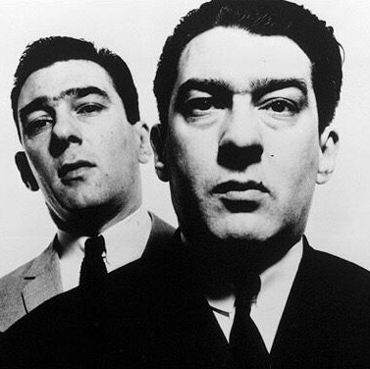
INTRODUCTION
Welcome to Criminology!

Slide 3
CRIMINOLOGY: WHAT YOU WILL STUDY?
YEAR 12
UNIT 1: Changing Awareness of Crime
Types of crime
Why are some crimes underreported?
Does media affect perceptions of crime?
The impact on our awareness of crime of campaigns for social change
UNIT 2: Criminological Theories
‘Criminal’ or ‘deviant behaviour?
Biological, psychological & sociological explanations of criminal behaviour
How do these theories influence, e.g. government policies on crime prevention or the sentencing of offenders?
Notes:
This official name of this course is the Applied Diploma in Criminology.
As a Level 3 qualification, it’s equivalent to an A Level and attracts the same number of UCAS points as all other A Levels - so this will help with your university applications.
Because it is an ‘applied’ qualification, the course focuses on aspects of the criminal justice system quite a bit: for instance, how the police investigate crime and how the criminal courts in England and Wales sentence offenders. We’ll also be looking at other issues such as how media reports influence our perception of the crime rate and explanations of why some people commit crime.
So, as you’ll spotted already, there are FOUR UNITS. We will study two per year. Briefly, the units are about the following issues:
Unit 1 is about how – and why – our perception of crime may change over time. We’ll investigate the factors that might influence or cause these changes. For instance, the Vagrancy Act 1824 makes vagrancy – specifically begging - an offence. Why would we criminalise this? Increasingly, politicians, charities and other groups working with the homeless claim that turning these individuals into criminals is not the right way to deal with this particular social problem. How do we bring about changes in the criminal law and why, over time, do some activities stop being criminalised? Can individuals or groups influence the criminal law, law-makers, police and the courts through their campaigns for change? Another example for you: like most countries, we’ve had to deal with different types of terrorism and in the last two decades, our Parliament (and sometimes our criminal courts) has created many new terrorist offences to deal with this threat. Which terrorist incidents in particular, have led to the creation of new offences? Do you think that people might feel safer as a result of them? Why is that most countries no longer impose the death penalty on murderers while China, Iran, Saudi Arabia, Iraq and Egypt execute the most offenders (according the campaigning group, Amnesty International)? That question leads on to another: how far is our perception of crime influence by the tv news or social media? Many people learn about the fear and fascination of crime from the media, but is the media a reliable source of information? To what extent are we misled by our tastes in programmes and newspapers about crime? Who decides what behaviours should be against the law? Who gathers information about crime? Can this information be trusted? Can we trust our own instincts? Two final questions for you: why are some crimes – such as drug misuse, domestic violence and hate crime – underreported to police? And, how do Criminologists know that some offences tend to be reported less often to police? We’ll be considering these questions and more.
Unit 2 is all about theory: theories, or explanations of why some people commit crime. The fact is that every society criminalises and punishes certain behaviours such as murder and theft. This means that every society has criminals, so many groups and organisations such as politicians, are keen to understand the factors that lead some individuals to commit crime. Sociologists and Criminologists have come up with lots of theories to explain this. Much of this is about what Criminologists refer to as the nature-nurture debate. For example, do some individuals inherit a ‘criminal’ gene or might they have a combination of genes that make its more likely that they will commit crime? Is a fault with their personality? Is their family background or lack of meaningful opportunities, education or poverty the cause of their behaviour? Which is the most useful? Are these theories relevant to all types of crime? What can we learn from the strengths and weaknesses of each? How can these theories be applied to real life scenarios and real life crimes?
Also, how do we decide what behaviour is criminal? What is the difference between criminal behaviour and deviance?

Slide 4
CRIMINOLOGY: WHAT YOU WILL STUDY?
Year 13
UNIT 3: From crime scene to courtroom
The investigation and prosecution of offences
The role of police, offender profilers and other personnel in the Criminal Justice System
Rights of suspects during police interview
UNIT 4: Crime and Punishment
Social control, punishment and the aims of the sentencing of offenders
Role of, e.g. National Probation Service and other agencies involved in the management of offenders
Notes:
In year 13 – the second year of your study – you’ll complete Units 3 and 4.
Unit 3 is all about applying your knowledge. We’ll be following the investigation of crime. So, there are lots of officials who will be involved in the investigation of serious crime such as murder. We’ll examine the powers of police officers as they do their job and how, sometimes, offenders profilers – who tend to be psychologists – can help the police narrow down their search for suspects. We’ll examine the different types of evidence that may be gathered in an investigation and ask how the Crown Prosecution Service decides which cases to pursue. What are the rights of suspects during police interviews? What do solicitors do and what factors inside – and outside the courtroom – may influence a jury’s decision in a criminal case?
Unit 4 focuses on social control, punishment and the aims of sentencing. We’ll be asking a lot of questions here. For example, why do most of us not commit crime? What social controls stop us? We’ll investigate the aims of sentencing – retribution, deterrence and rehabilitation - and investigate how different types of sentences reflect these aims. There are lots of agencies involved in the management of offenders once they’ve been sentenced for their crimes so we’ll look at the role of government agencies like the Prison Service and Probation Officers as well.

Slide 5
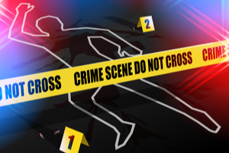
Assessments: 50% coursework, 50% exams
4 assessments in total
Each is worth 25% of the final grade
2 assessments each year
Units 1 & 3: controlled assessment (8 hours in class)
Units 2 & 4: exam (90 mins)
Notes:
In a nutshell, this course is assessed in TWO ways: coursework and exams. It’s a straightforward split between them: 50% coursework and 50% exams.
So, here’s a quick run-through of how this will work:
Unit 1 is assessed through CONTROLLED ASSESSMENT. You’re probably familiar with this already from GSCE. You’ll have 8 hours to respond to an unseen case study. Just to reassure you, this will be completed over several days! This will probably take place in January 2021. You’ll be able to take your notes into the classroom so it’s a good idea to make sure their accurate and complete.
Unit 2 is assessed in a one and a half hour EXAM. Usually, the exam board will give students scenarios – you may know them as case studies – and ask a series of questions where you’ll be required to apply your knowledge in order to get marks. The exam will take place in May or June 2021.
Unit 3: again, this will be assessed through controlled coursework.
Unit 4: it’s another exam – to be sat in May/June 2022.
The next slide contains questions from past exam papers – just to give you an idea of the styles of questions in the exam papers.

Slide 6
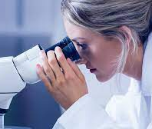
ENTRY REQUIREMENTS
5 GCSEs at grade C including English Language
Notes:
Good writing skills and ability to put together detailed, accurate explanations of things are essential skills for this course. So, we ask for a grade 5 in English. Above all though, an enquiring mind is a must for success in Criminology: it’s ok to ask questions and to think about the complexities of issues.

Slide 7
Draw a criminal
On a piece of paper in front of you, draw your idea of what a criminal looks like.
Think about their facial features, their expression etc.
Draw it in as much detail as you can (don’t worry if you're not an artist!!)

Slide 8
Go back to your criminal
Around the outside, write down what kind of personality traits etc they might have.

Slide 9
Plenary
Where do your ideas of what a criminal looks like come from?
What influences in your life could have affected your ideas?
What influences in society could have affected your ideas?
Why are some of your ideas similar?
Why are some of your ideas different?
What can we take from this about our ideas of what a criminal looks like?

Slide 10
Thanks for joining me!
Hope to see you in September!
Questions??

